Slide 1
Spotify Trends
Mengchen Gong, Juan Ferrer Peasley, Carlos Prieto Fernandez

Slide 2
Accomplished
Milestone 4: Analyze combined features correlation to popularity
Milestone 5: Comparison/analysis with other related datasets
Milestone 6: Outlier Analysis
Milestone 1: Data analyze to see how the features affect the popularity
Milestone 2: Analyze correlations among features
Milestone 3: Make conclusions about the correlations

Slide 3
Juan’s
Original Dataset Analysis
Popularity mean by: genre, key and time signature
Probability of popularity given Genre and Feature
New Datasets Analysis
Correlation Heatmap, Boxplot, Scatter plot comparison
Popularity trends over time (2016-2019)
Correlation heat map, and scatter plot of each year
Top artists each year
Song features increase and decrease throughout time
Future trend predictions

Slide 4
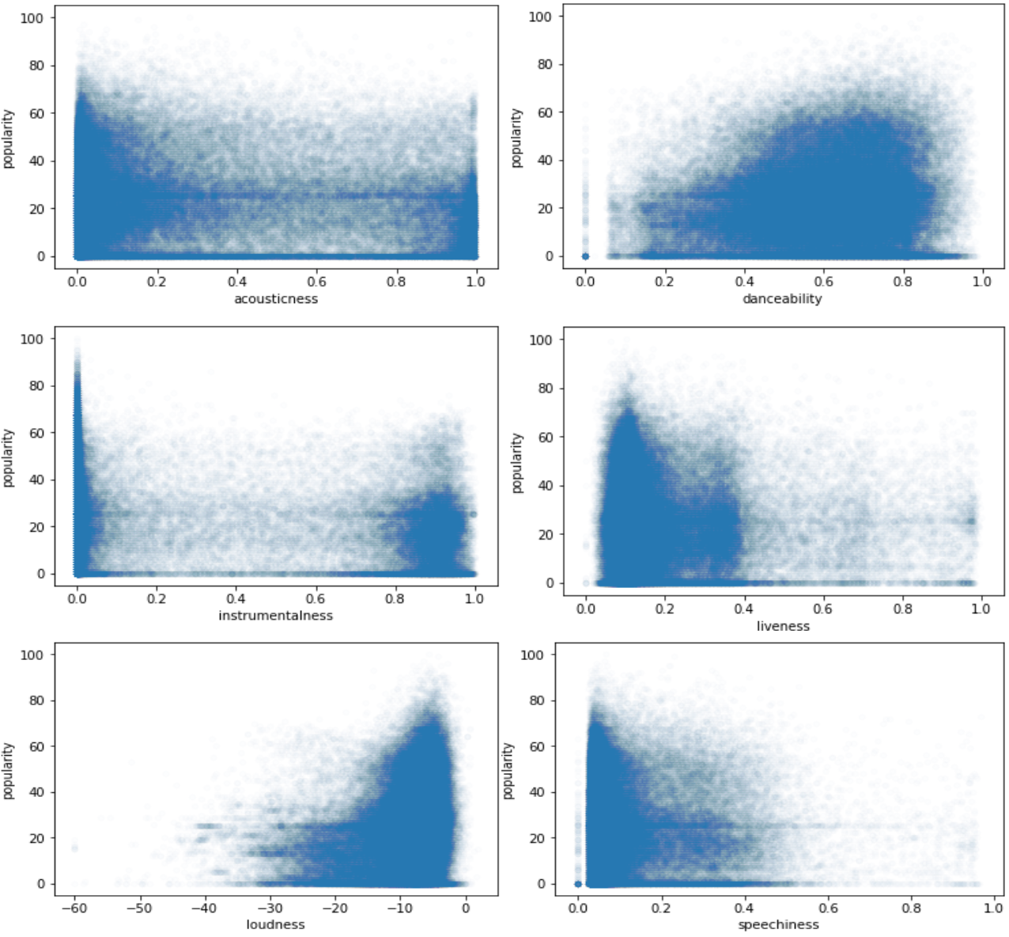
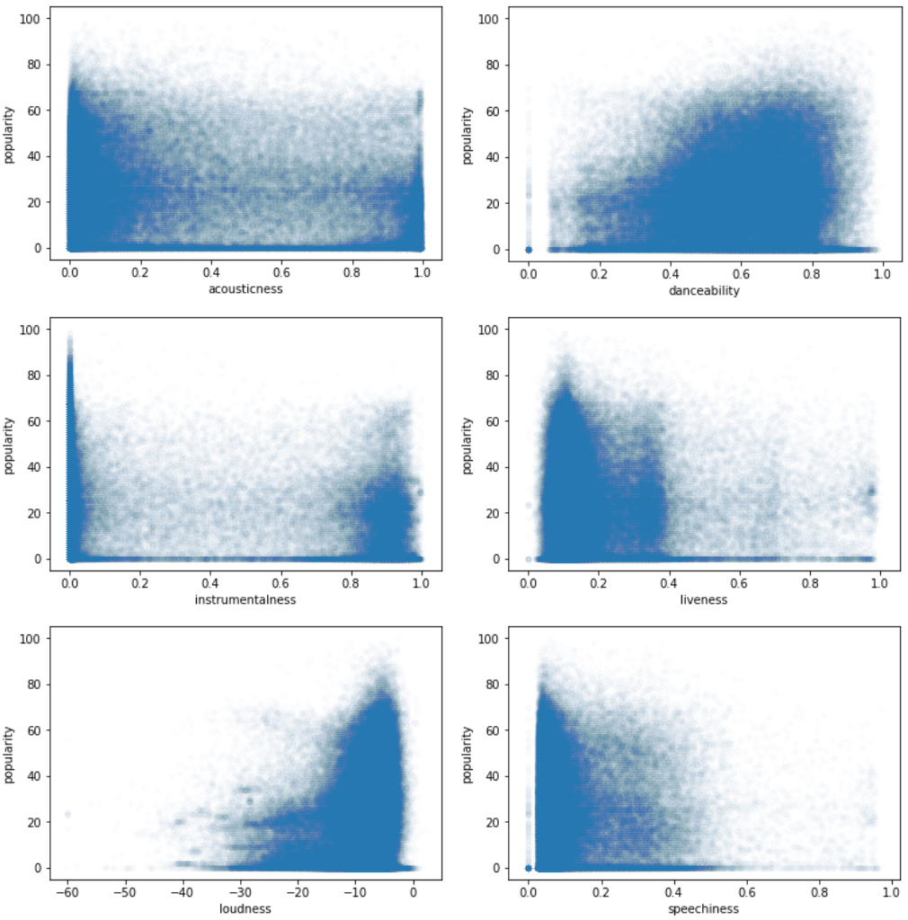
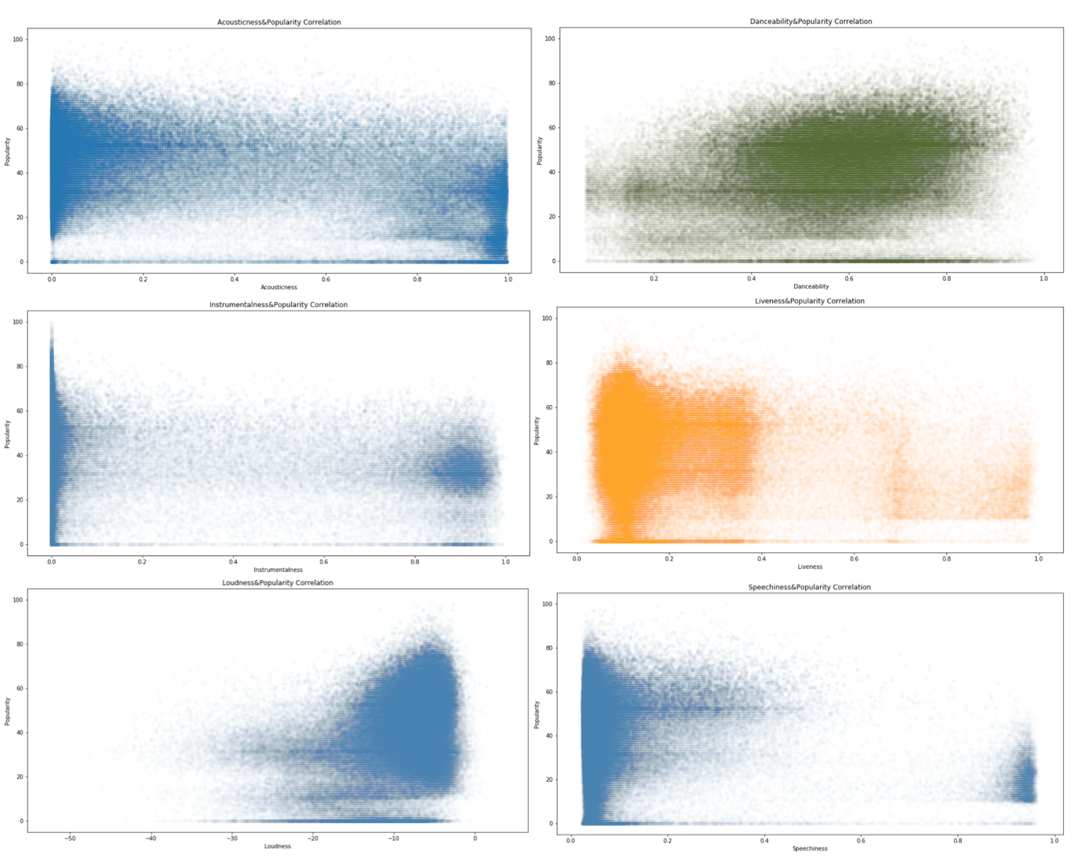
New: 2017
New: 2018
Original: 2019

Slide 5
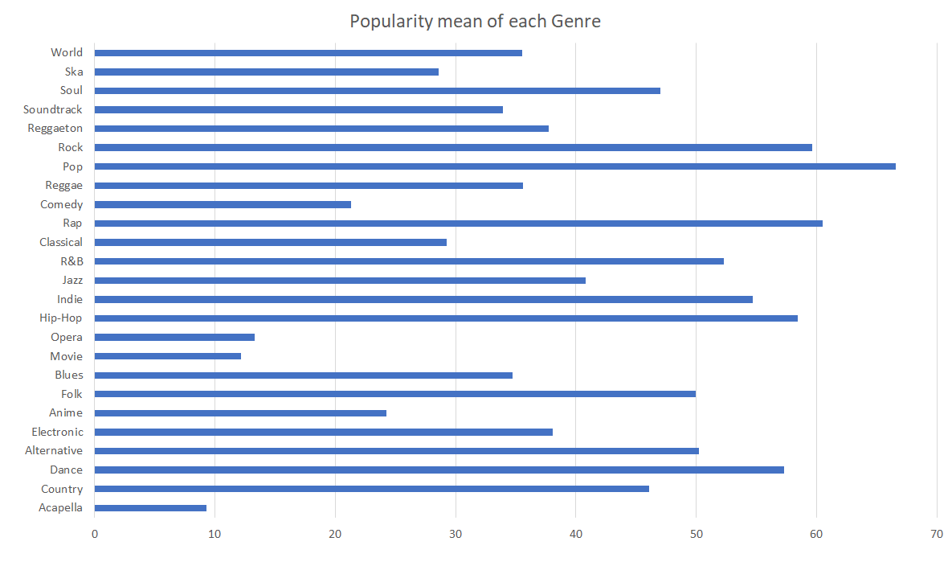

Slide 6
EVOLUTION OF POPULARITY OF EACH MUSIC FEATURE
Top hits (2016 - 2019)

Slide 7
Top Artists each year
2016
2017
2018
2019
Zara Larsson 5
Shawn Mendes 4
J. Cole 3
Alessia Cara 3
Ariana Grande 3
The Chainsmokers 3
Rihanna 3
Justin Bieber 3
Jonas Blue 3
DJ Snake 2
George Michael 2
Sia 2
Britney Spears 2
Cheat Codes 2
Calvin Harris 2
Chuck Berry 2
The Chainsmokers 4
Drake 3
Martin Garrix 3
Bruno Mars 2
Luis Fonsi 2
Clean Bandit 2
Maroon 5 2
DJ Khaled 2
The Weeknd 2
Calvin Harris 2
Ed Sheeran 2
XXXTENTACION 6
Post Malone 5
Drake 4
Maroon 5 2
The Weeknd 2
Ariana Grande 2
Ozuna 2
Migos 2
Selena Gomez 2
Clean Bandit 2
Calvin Harris 2
Ariana Grande 8
Why Don't We 3
Ava Max 2
Lady Gaga 2
The Chainsmokers 2
Lil Baby 2
Shawn Mendes 2
Daddy Yankee 2
Luis Fonsi 2
J. Cole 2
Bebe Rexha 2
ChocQuibTown 2
DJ Snake 2

Slide 8
Artists with hits multiple years
Artists with the most amount of hits since 2016
Calvin Harris: 2016, 2017, 2018
The Chainsmokers: 2016, 2017, 2019
Ariana Grande: 2016, 2018, 2019
DJ Snake: 2016, 2019
Drake: 2017, 2018
Luis Fonsi: 2017,2019
Shawn Mendes: 2016, 2019
The Chainsmokers: 9
Ariana Grande: 8
Shawn Mendes: 6
XXXTENTACION: 6
Winner: The Chainsmokers

Slide 9
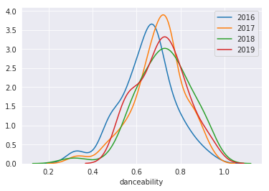
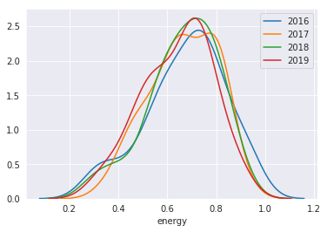
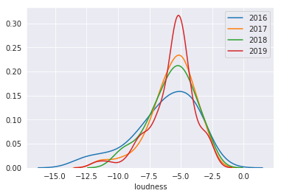
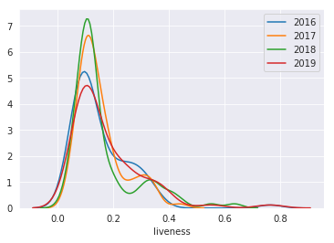

Slide 10
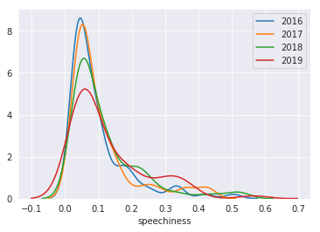
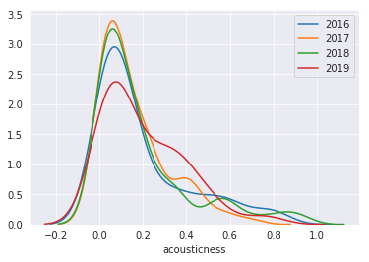

Slide 11
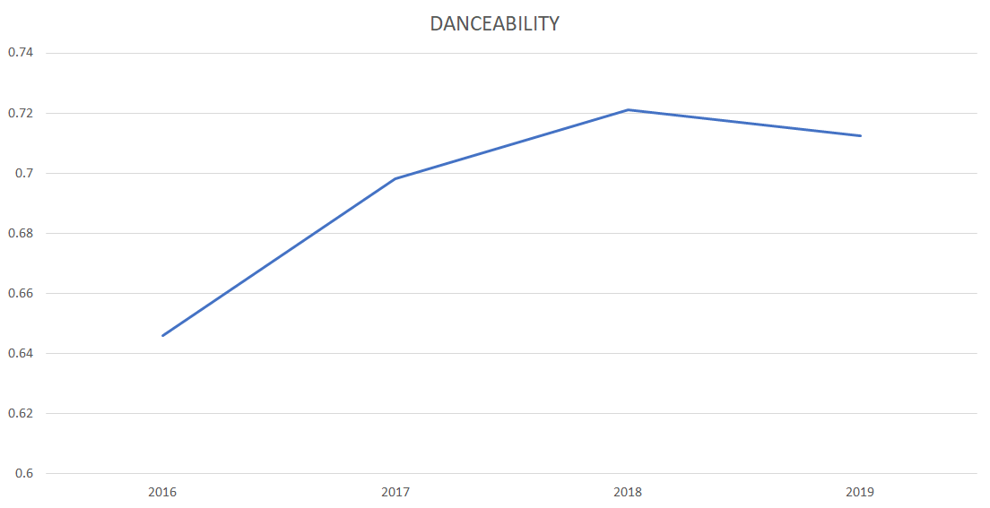

Slide 12
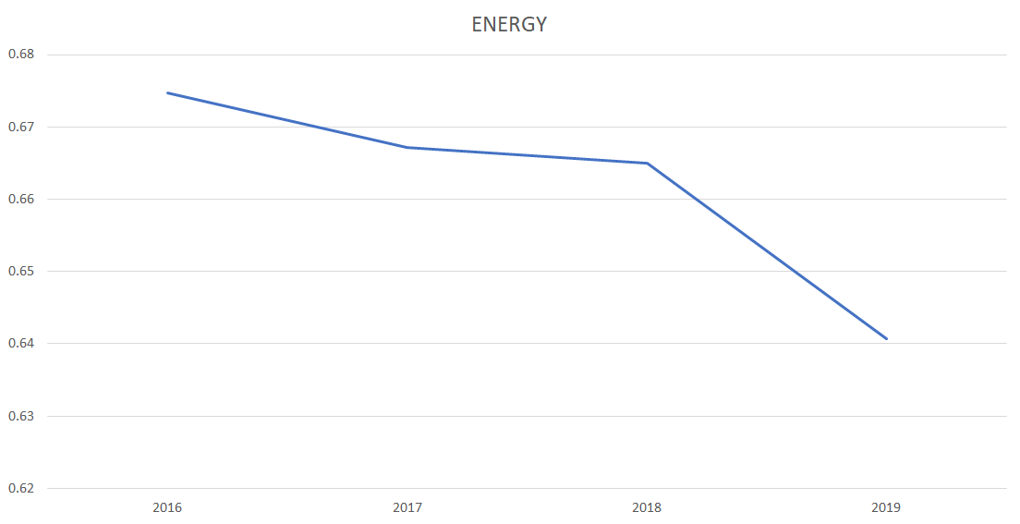

Slide 13
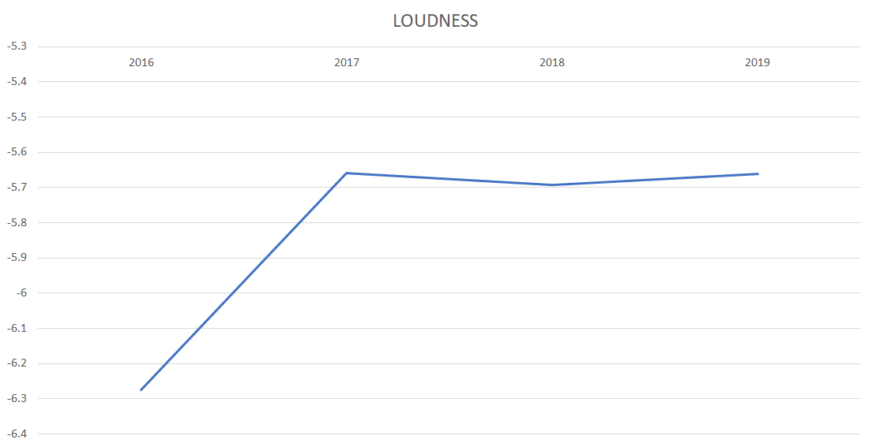

Slide 14
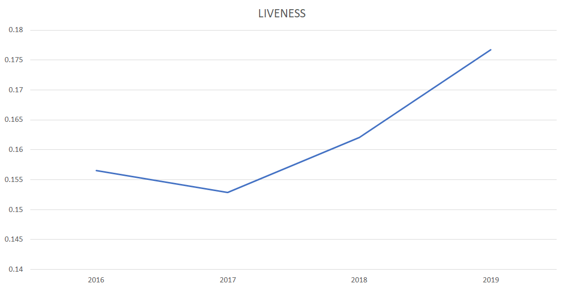

Slide 15
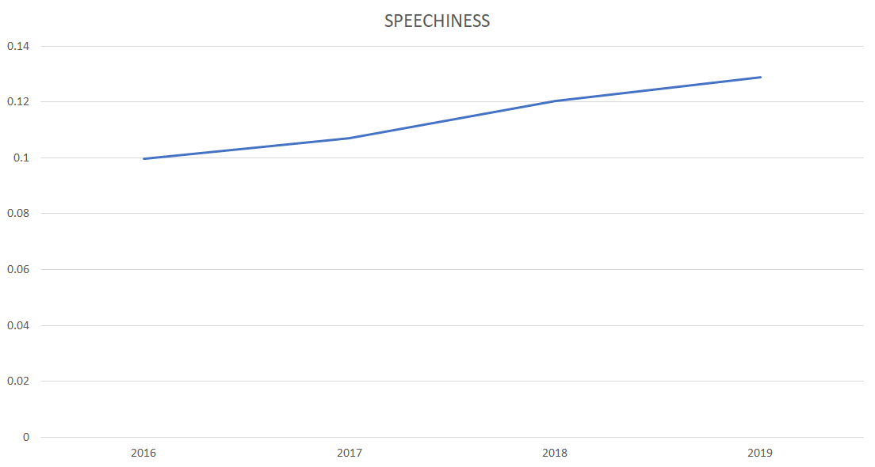

Slide 16
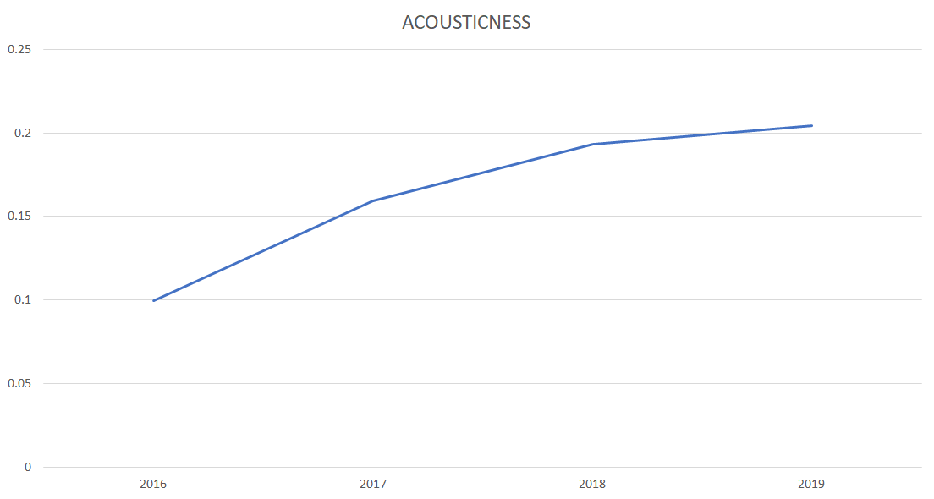

Slide 17
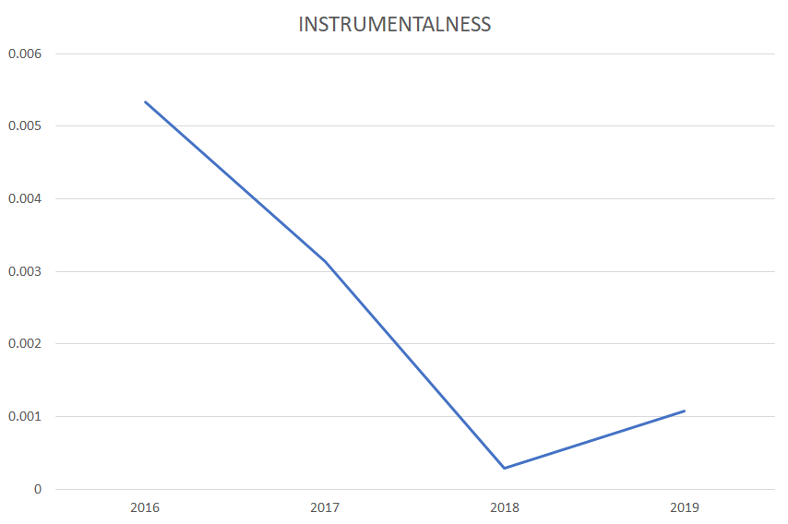

Slide 18
Notable music trends over time (2016-2019)
Danceability: + 10.33% → Decreasing
Energy: - 5.04% → Decreasing
Loudness: + 9.76% → Increasing
Liveness: + 12.91% → Increasing
Speechiness: + 29.42% → Increasing
Acousticness: + 105.12% → Increasing
Instrumentalness: - 79.89% → Increasing

Slide 19
Mengchen’s
Nominal data: average, ranking
Numerical data: scatter plot
Data Visualization
Feature correlation
- -
Combined feature correlation
Outlier Analysis
Data-simplification
Trend analysis
Popularity Prediction (binary)

Slide 20
Before Data Simplification & Regrouping

Slide 21
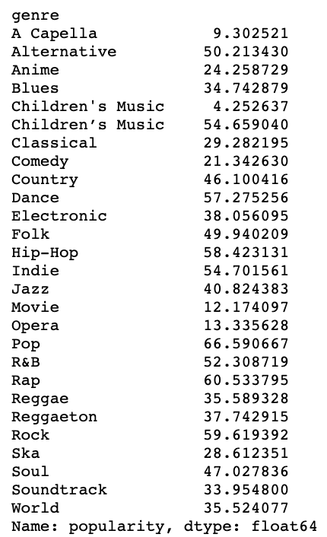
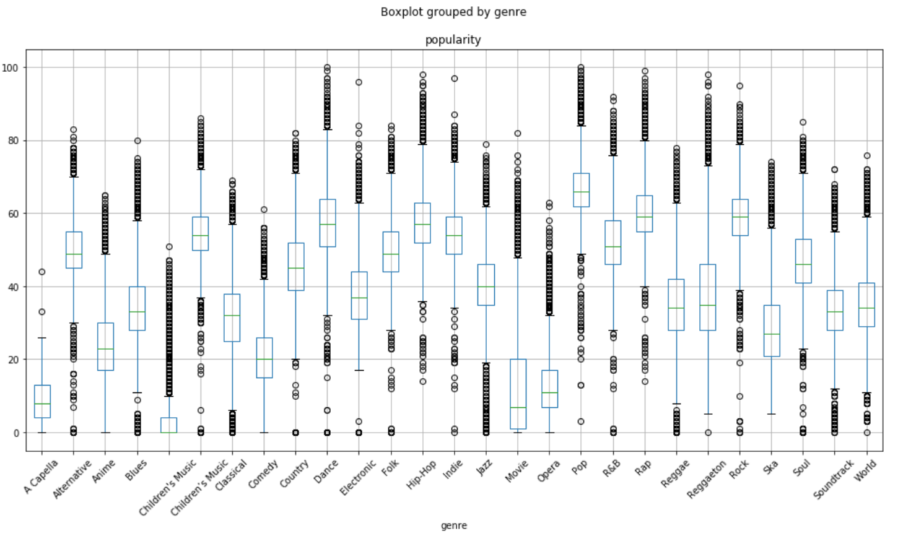

Slide 22
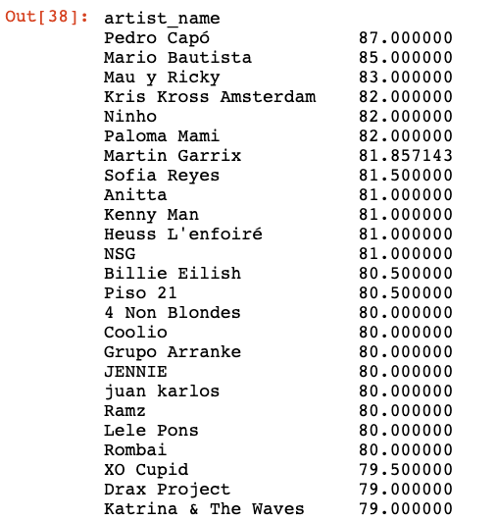

Slide 23
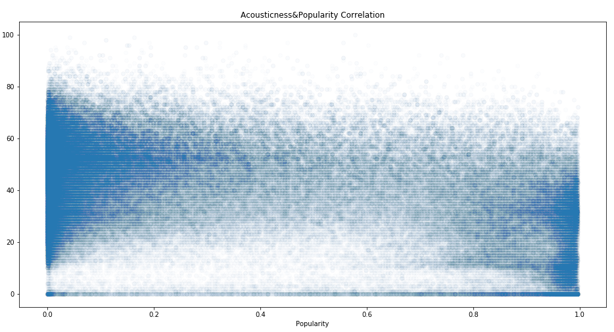
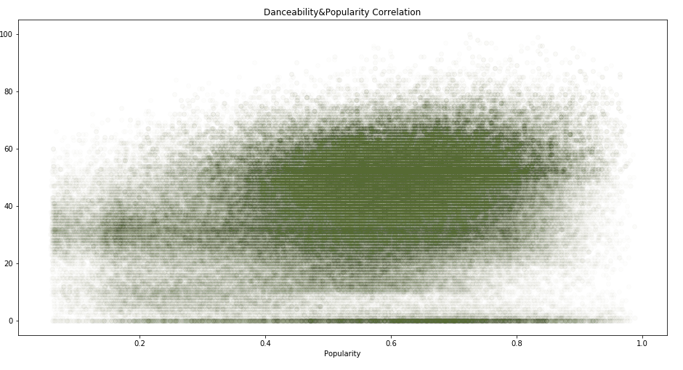
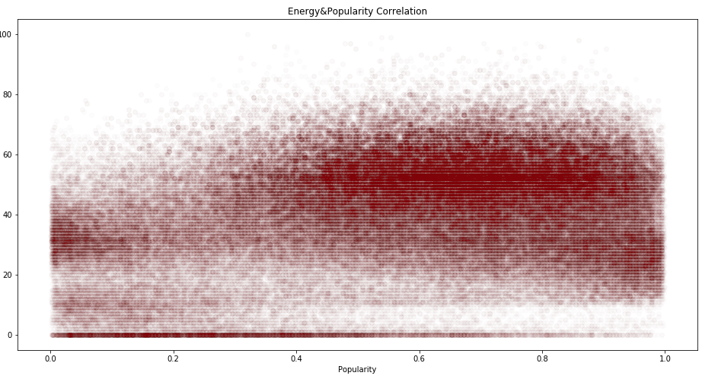
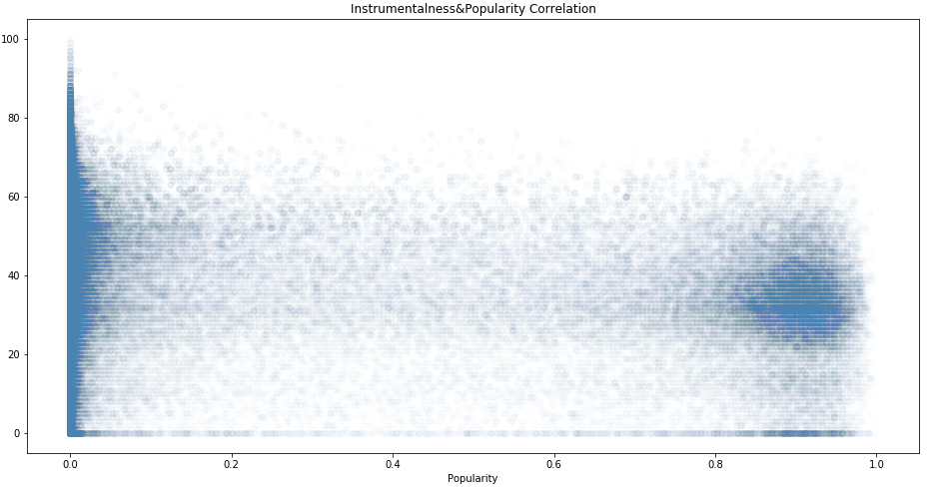

Slide 24
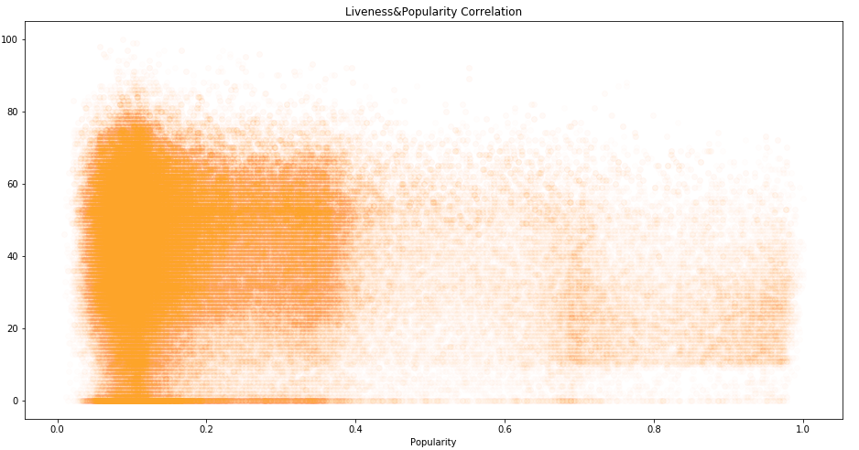
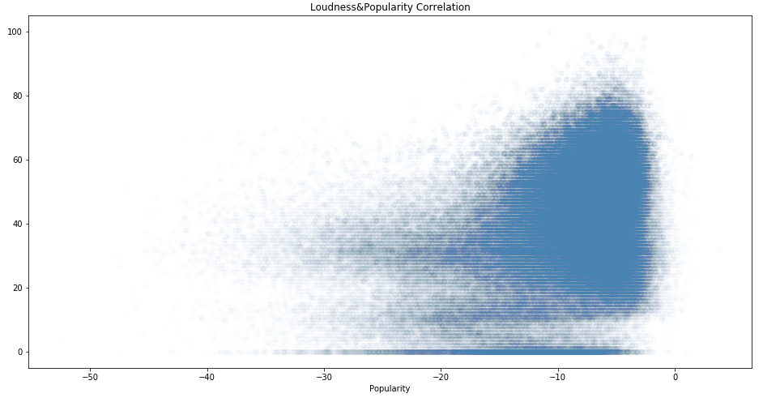
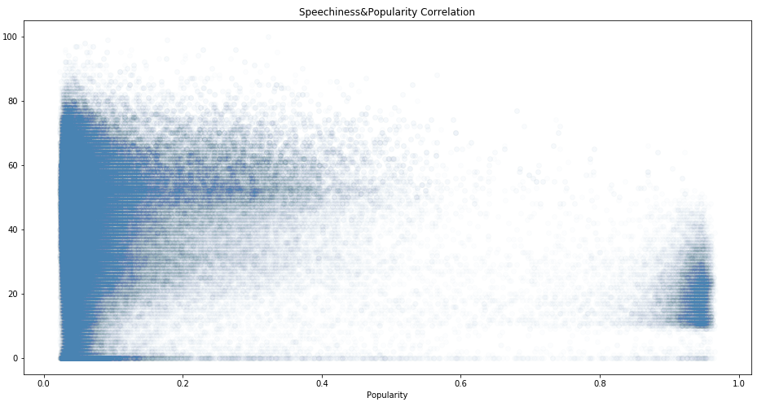
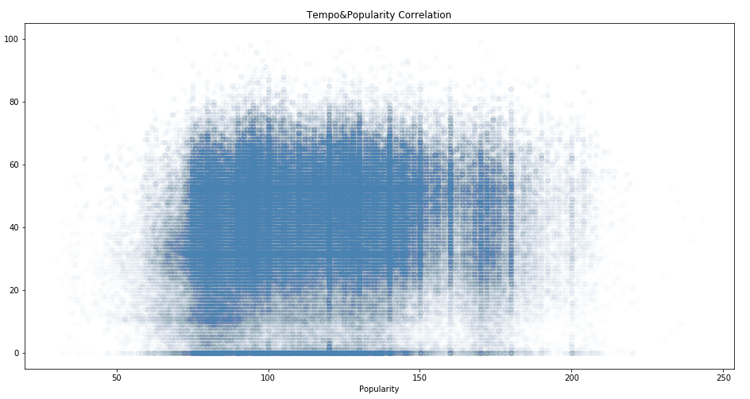

Slide 25
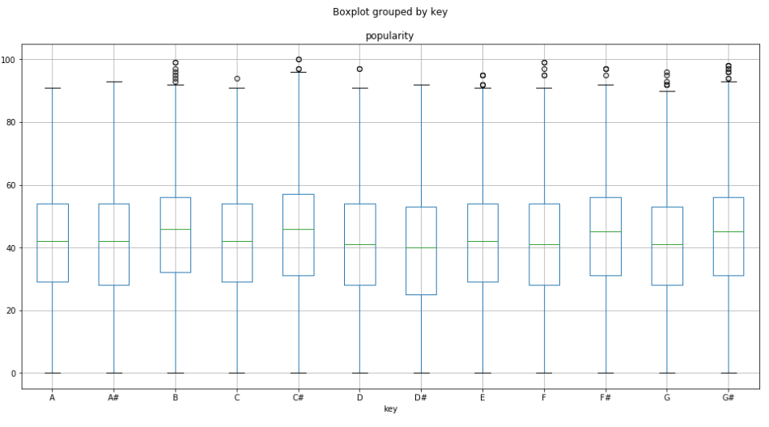
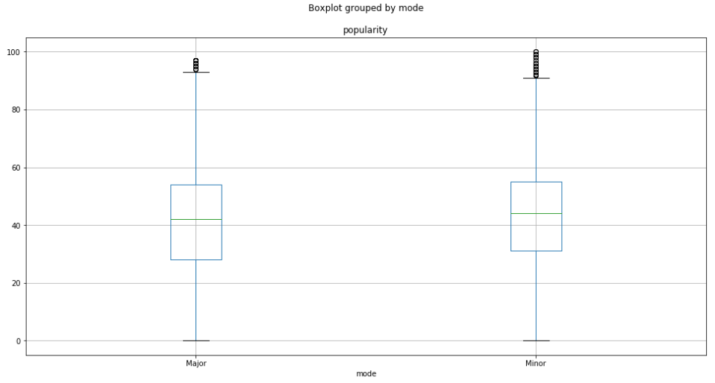
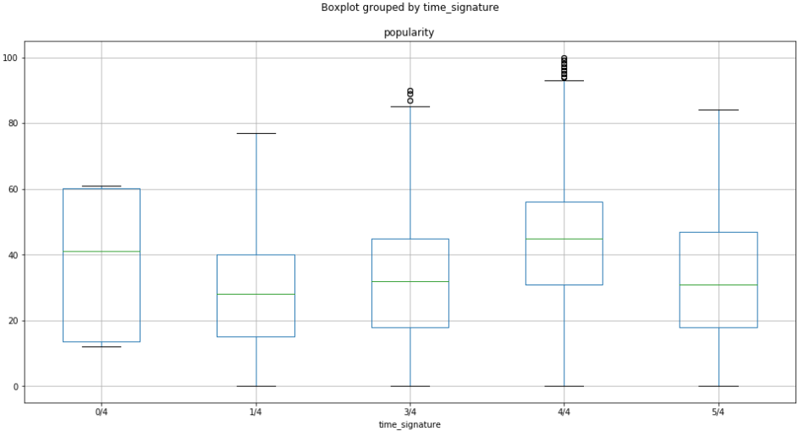
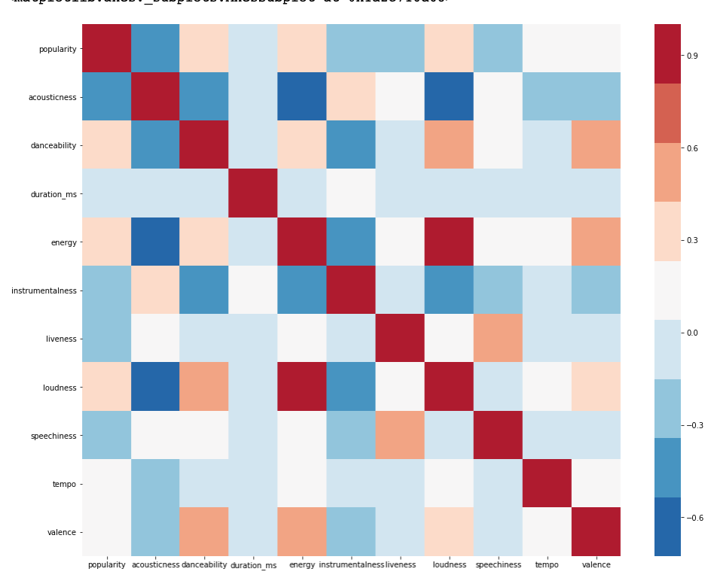

Slide 26
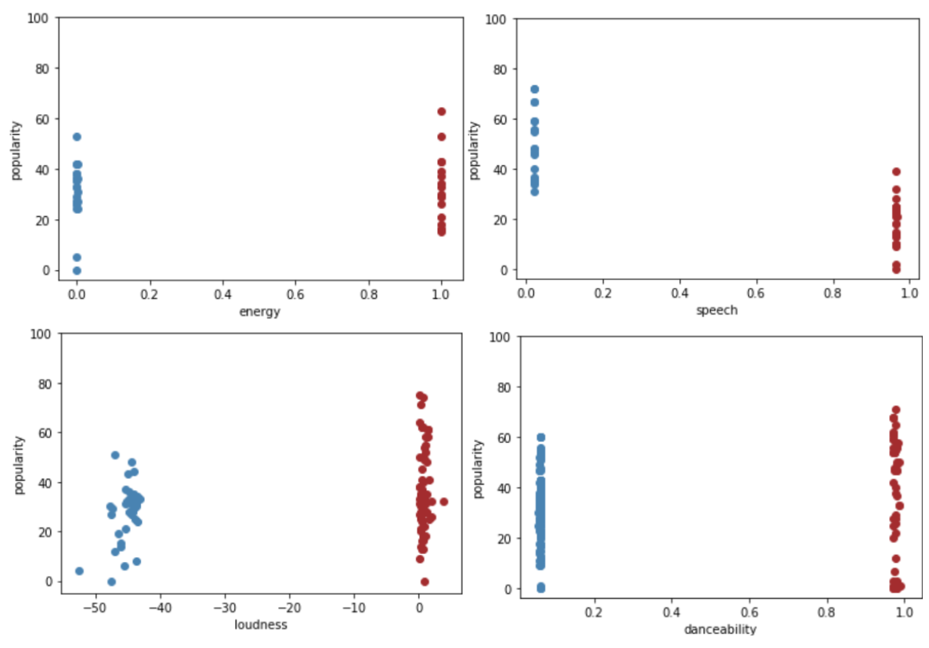
Outlier Analysis

Slide 27
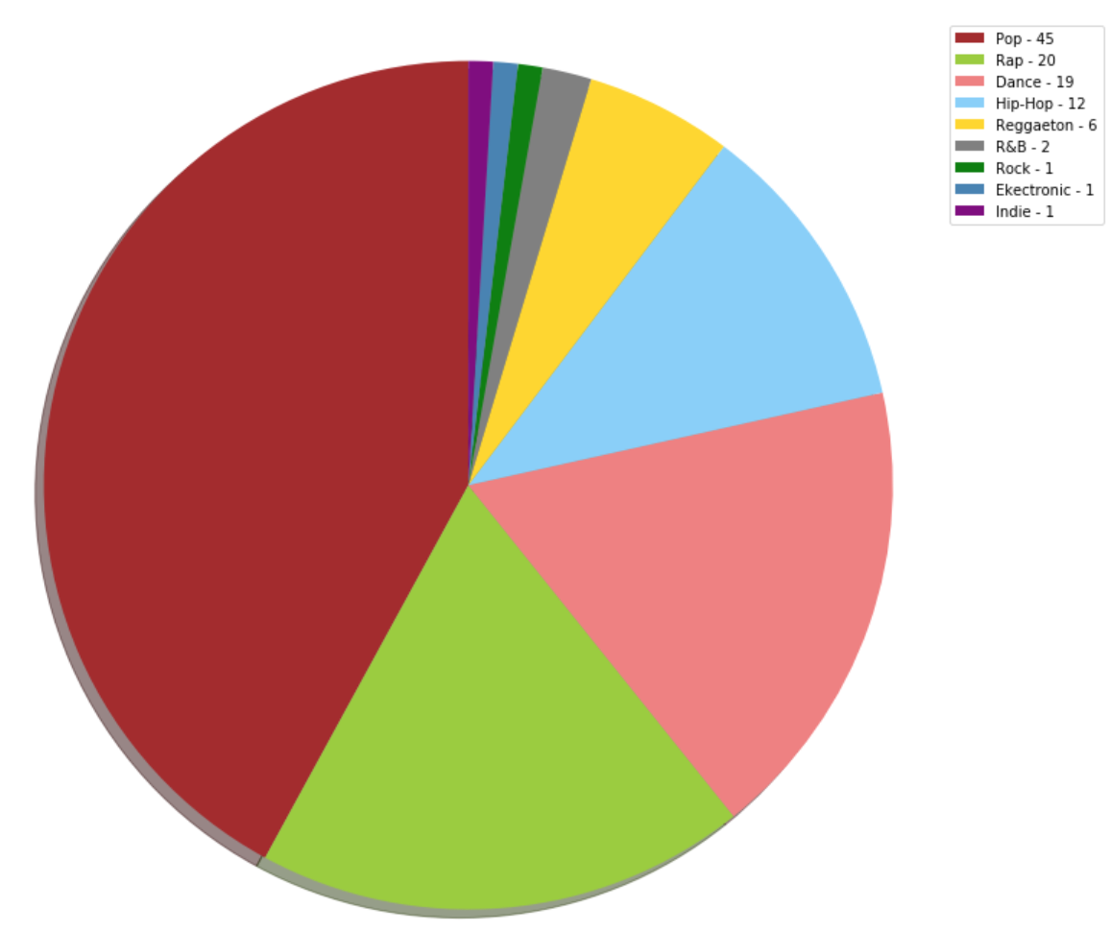
Top 5 Group Analysis

Slide 28
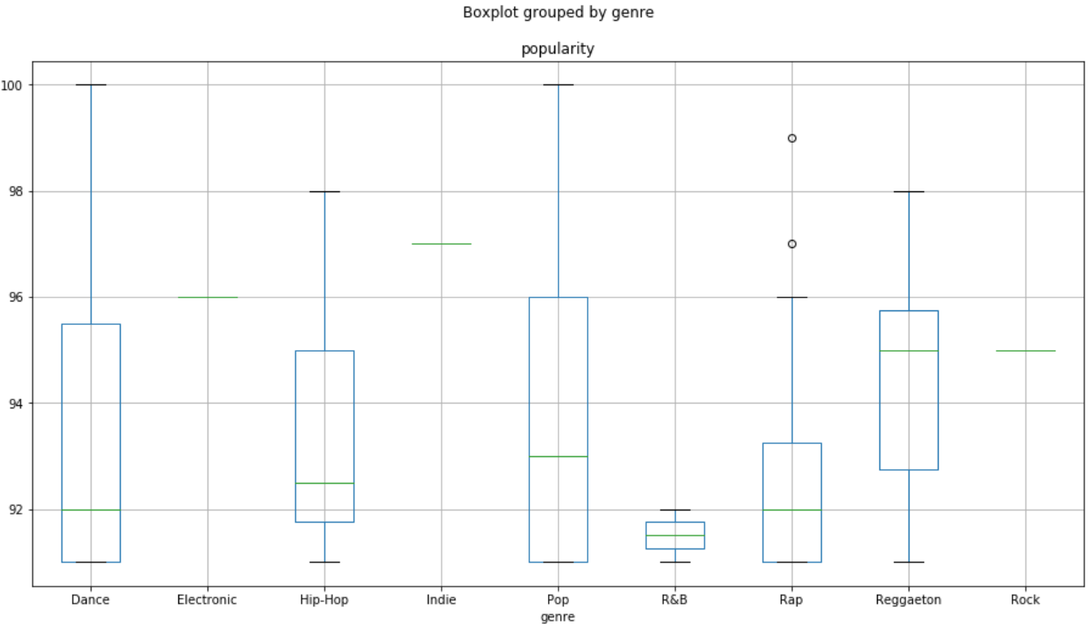

Slide 29
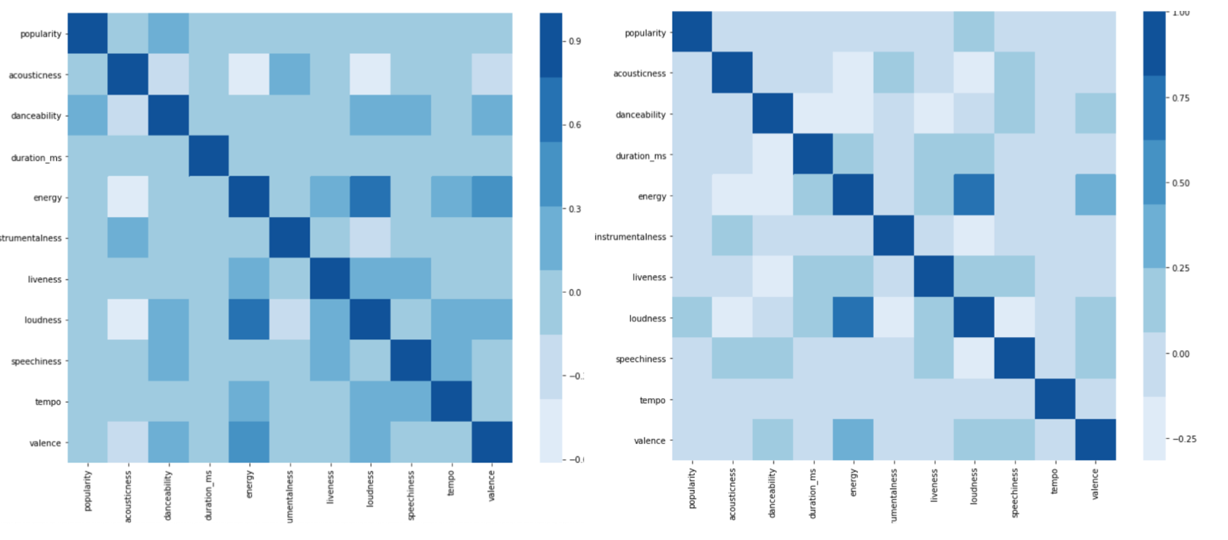
Pop vs. Rap

Slide 30
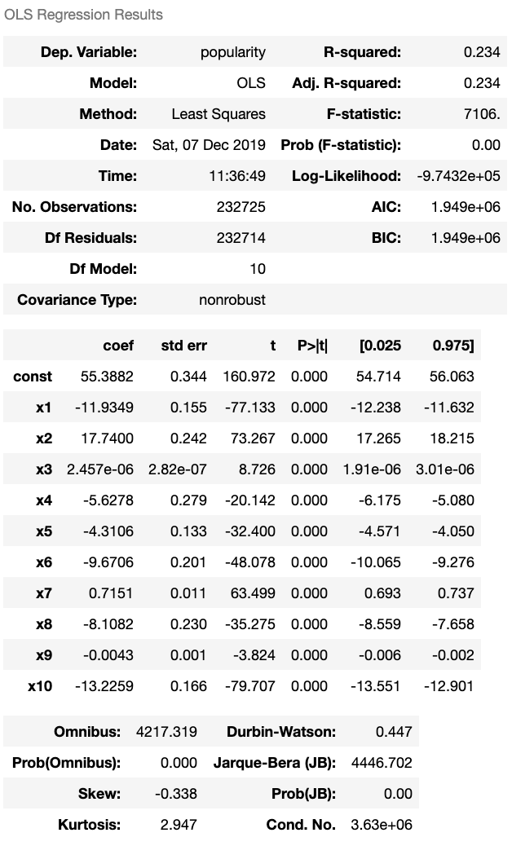

Slide 31
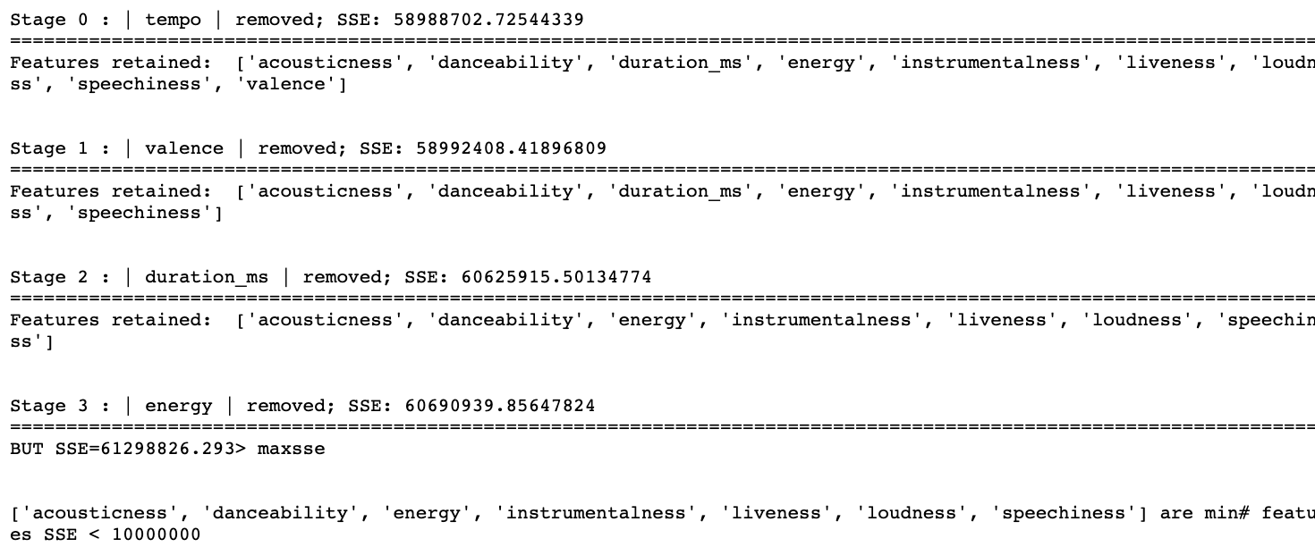
Backward Selection

Slide 32
Data Simplification

Slide 33
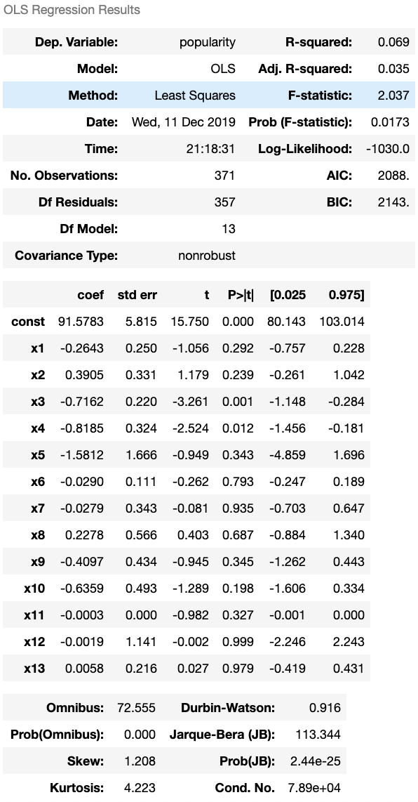
Top 5 Group Analysis

Slide 34
Pop: Danceability, Loudness, Valence
Rap: Danceability, instrumentalness, key, liveness, time_signagure, valence.
Rock: danceability, energy, speechiness, tempo, time_signature, valence.
Hip-Hop: acousticness, danceability, instrumentalness, key, livessness, tempo, time_signature.
Dance: danceability, liveness, speechiness, time_signature.

Slide 35
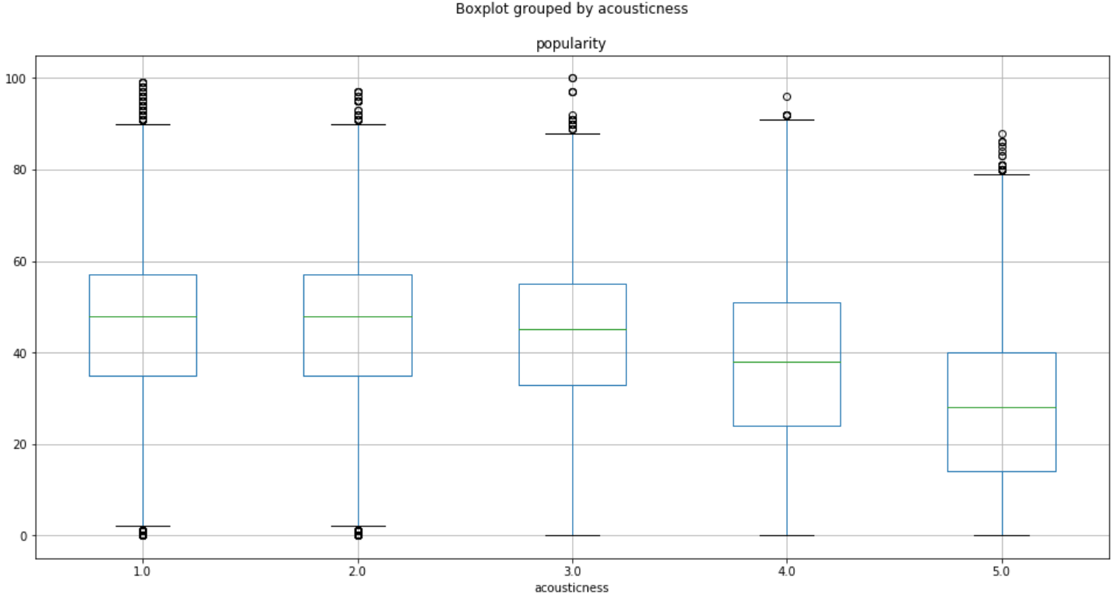
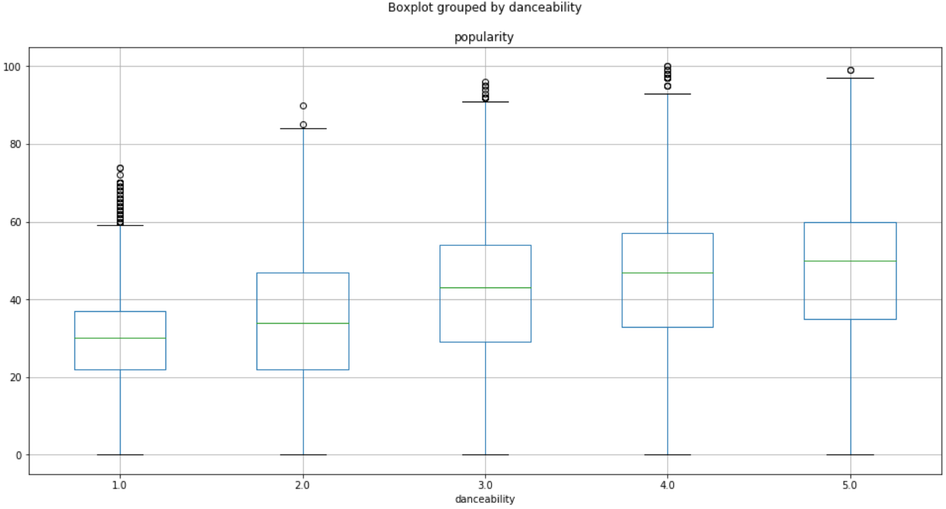
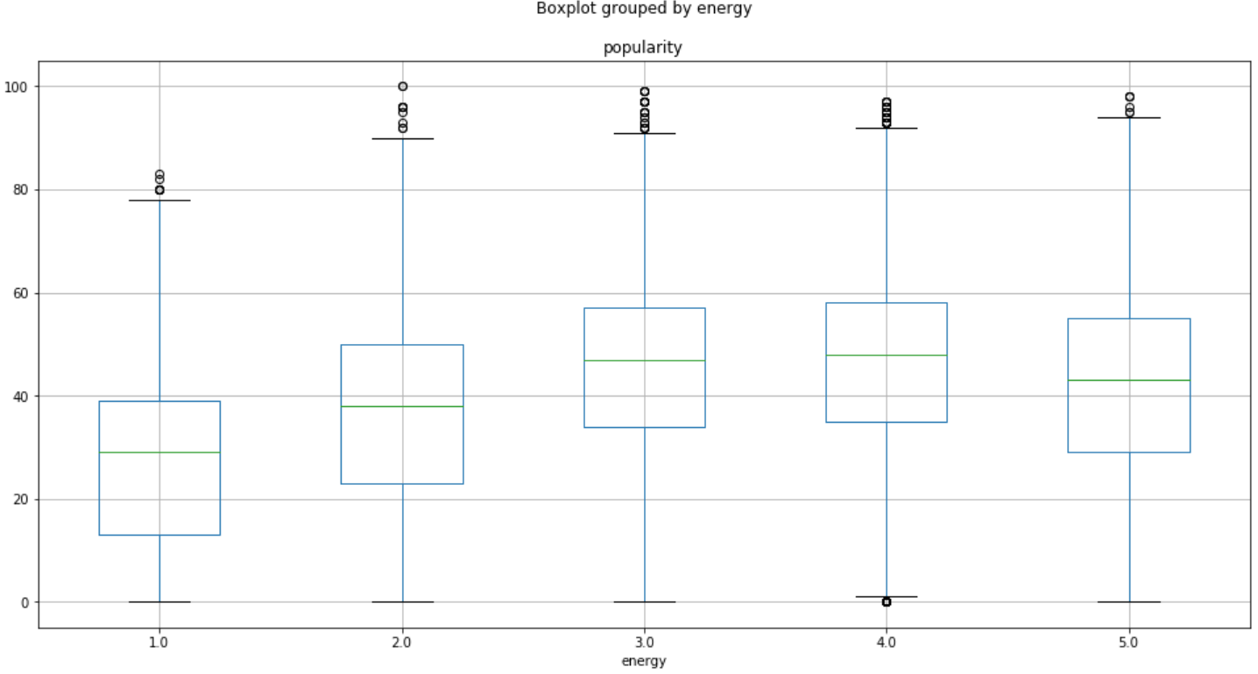
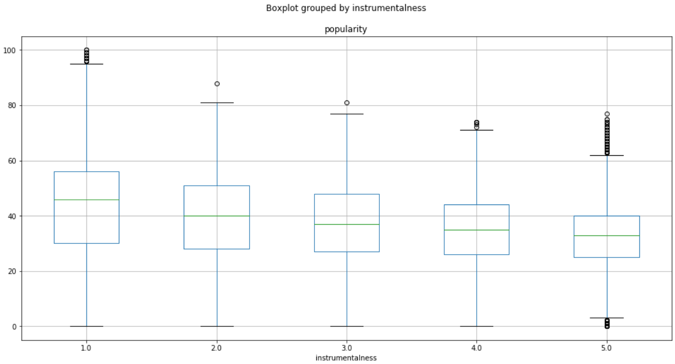

Slide 36
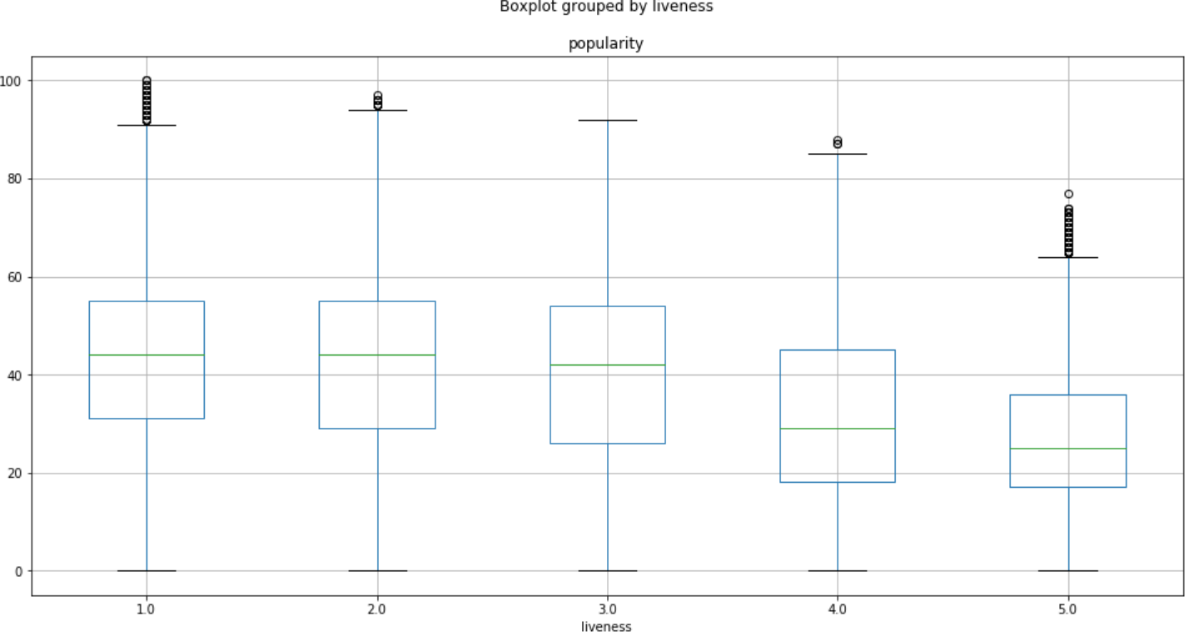
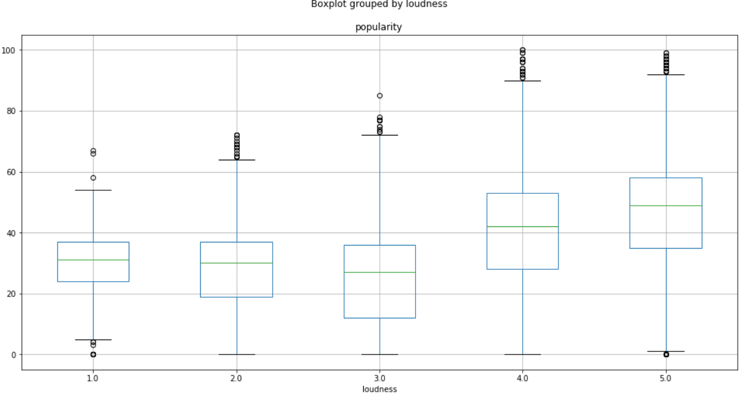
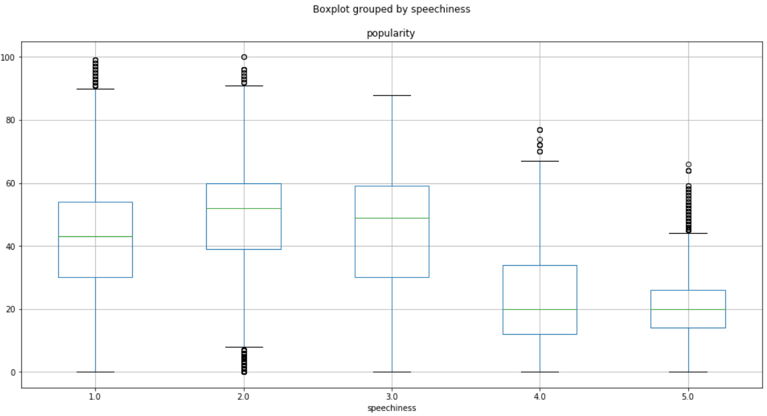
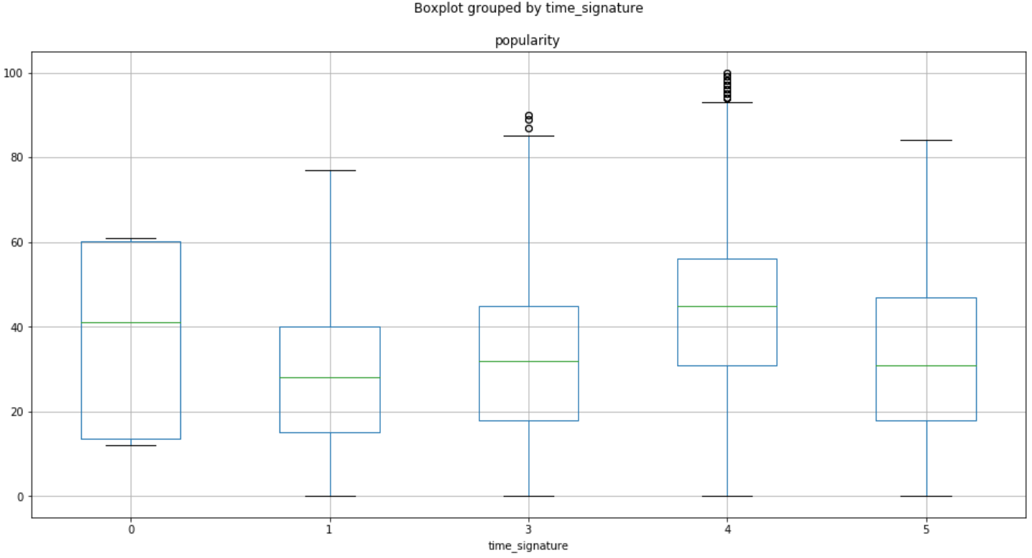

Slide 37
Binary Prediction
Correct predict percentage ~66%
Multi-linear Regression is needed

Slide 38
Carlos’
Feature correlations
Multiple Correlation
Multiple Linear Regression

Slide 39
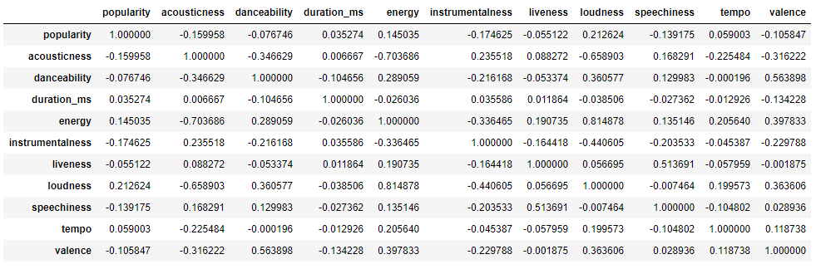

Slide 40
Model Implementation

Slide 41
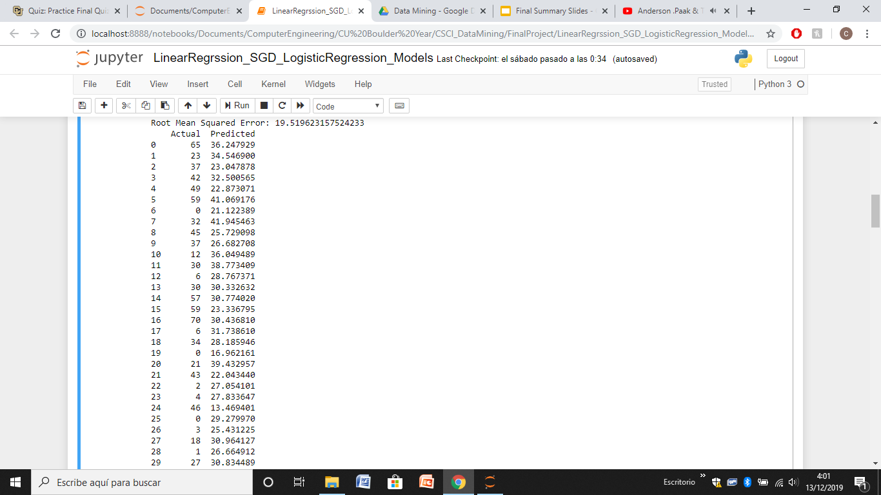
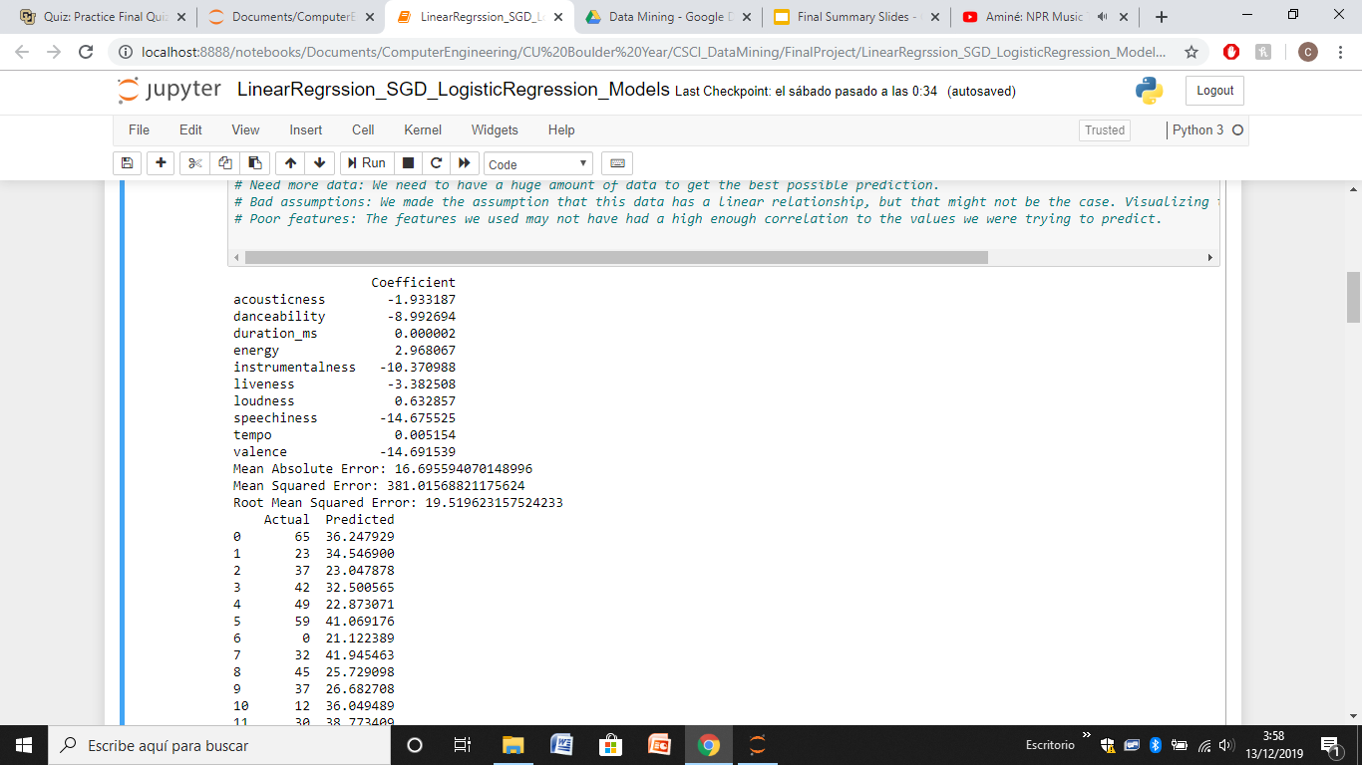
Linear Regression
Overview:

Slide 42
Need a better model that can handle many dimensions in data!

Slide 43

Logistic Regression
Best Features extraction:
Approach: Songs with popularity higher than 35 are considered popular. (70% songs below this value) We set them to 1 if they are popular and to 0 if they are below.
Training/Test : 80/20

Slide 44


Results

Slide 45

SGD
Best Features extraction:
Approach: Songs with popularity higher than 35 are considered popular. (70% songs below this value) We set them to 1 if they are popular and to 0 if they are below.
Training/Test : 80/20

Slide 46

Results

